Slide 1
Stock Investment Recommendation
EV Manufacturer - NIO
By Tiancheng Xu

Slide 2
01. Electric Vehicle Industry
02. About NIO
Outline
03. Valuation & Analysis
04. Financial Statements

Slide 3
PART ONE
Electric Vehicle Industry
01
Market, Current Players, Policies

Slide 4
01
EV Industry Market
The global electric vehicle market was valued at $162.34 billion in 2019, and is projected to reach $802.81 billion by 2027, registering a CAGR of 22.6%.
Asia-Pacific was the highest revenue contributor, accounting for $84.84 billion in 2019, and is estimated to reach $357.81 billion by 2027, with a CAGR of 20.1%. North America is estimated to reach $194.20 billion by 2027, at a significant CAGR of 27.5%. Asia-Pacific and Europe collectively accounted for around 74.8% share in 2019, with the former constituting around 52.3% share. North America and Europe are expected to witness considerable CAGRs of 27.5% and 25.3%, respectively, during the forecast period. The cumulative share of these two segments was 40.1% in 2019, and is anticipated to reach 51.0% by 2027.¹
1 https://www.alliedmarketresearch.com/electric-vehicle-market

Slide 5

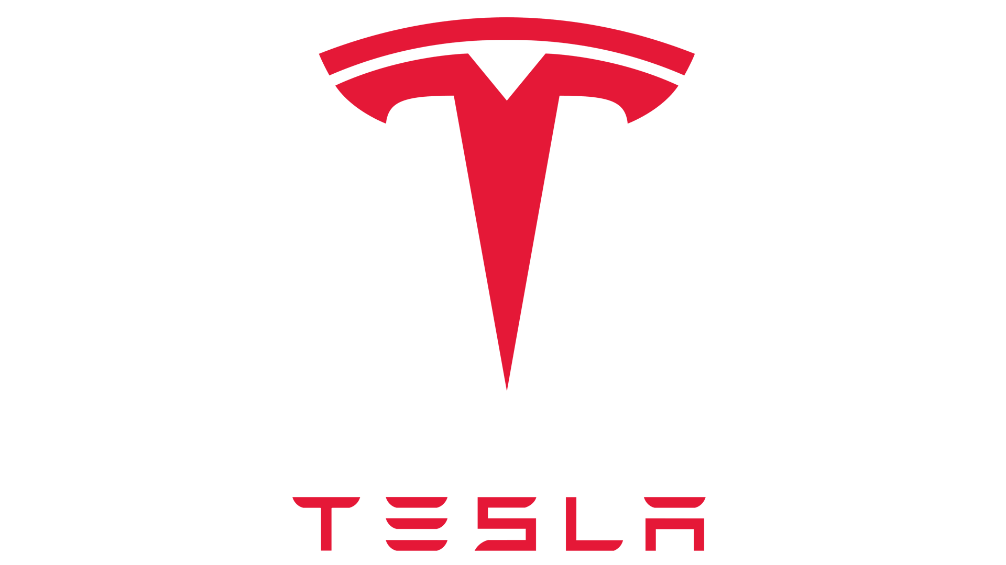




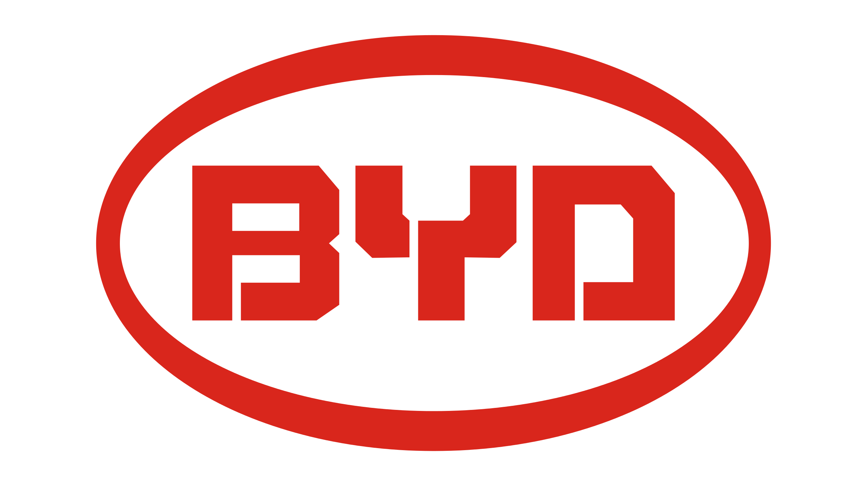



01
EV Industry Players
Other big players in EV industry include current industry leader Tesla, traditional automobile manufacturers such as Volkswagen AG (Volkswagen, Audi, Porsche), Daimler AG (Mercedes-Benz), BMW Group and Toyota Motor, as well as emerging Chinese manufacturers such as BYD Auto, Li Auto (Lixiang) and Xpeng Motors (Xiaopeng) .

Slide 6
01
Policies on EV Industry
National and local-level actions to support electric vehicle deployment have been taken all around the world. Governments in Europe, East Asia and South Asia are offering subsidies to further stimulate the purchase of electric vehicles. Various countries are promptly expanding their network of public charging points as an effort to accelerate the transformation of automobile-electrification.¹
China and U.S. are currently the top two countries with the most motor vehicles. Chinese government has offered both national and local-level of subsidies as well as tax exemptions for EVs. U.S. federal government has also initiated a tax credit for plug-in electric vehicles purchased in 2010 or later.²
1 https://theicct.org/publications/electric-vehicle-policies-eu-cities
2 https://www.eesi.org/articles/view/comparing-u.s.-and-chinese-electric-vehicle-policies

Slide 7
PART TWO
About NIO
02
Products, Events, Services

Slide 8

02
NIO
NYSE: NIO

Slide 9
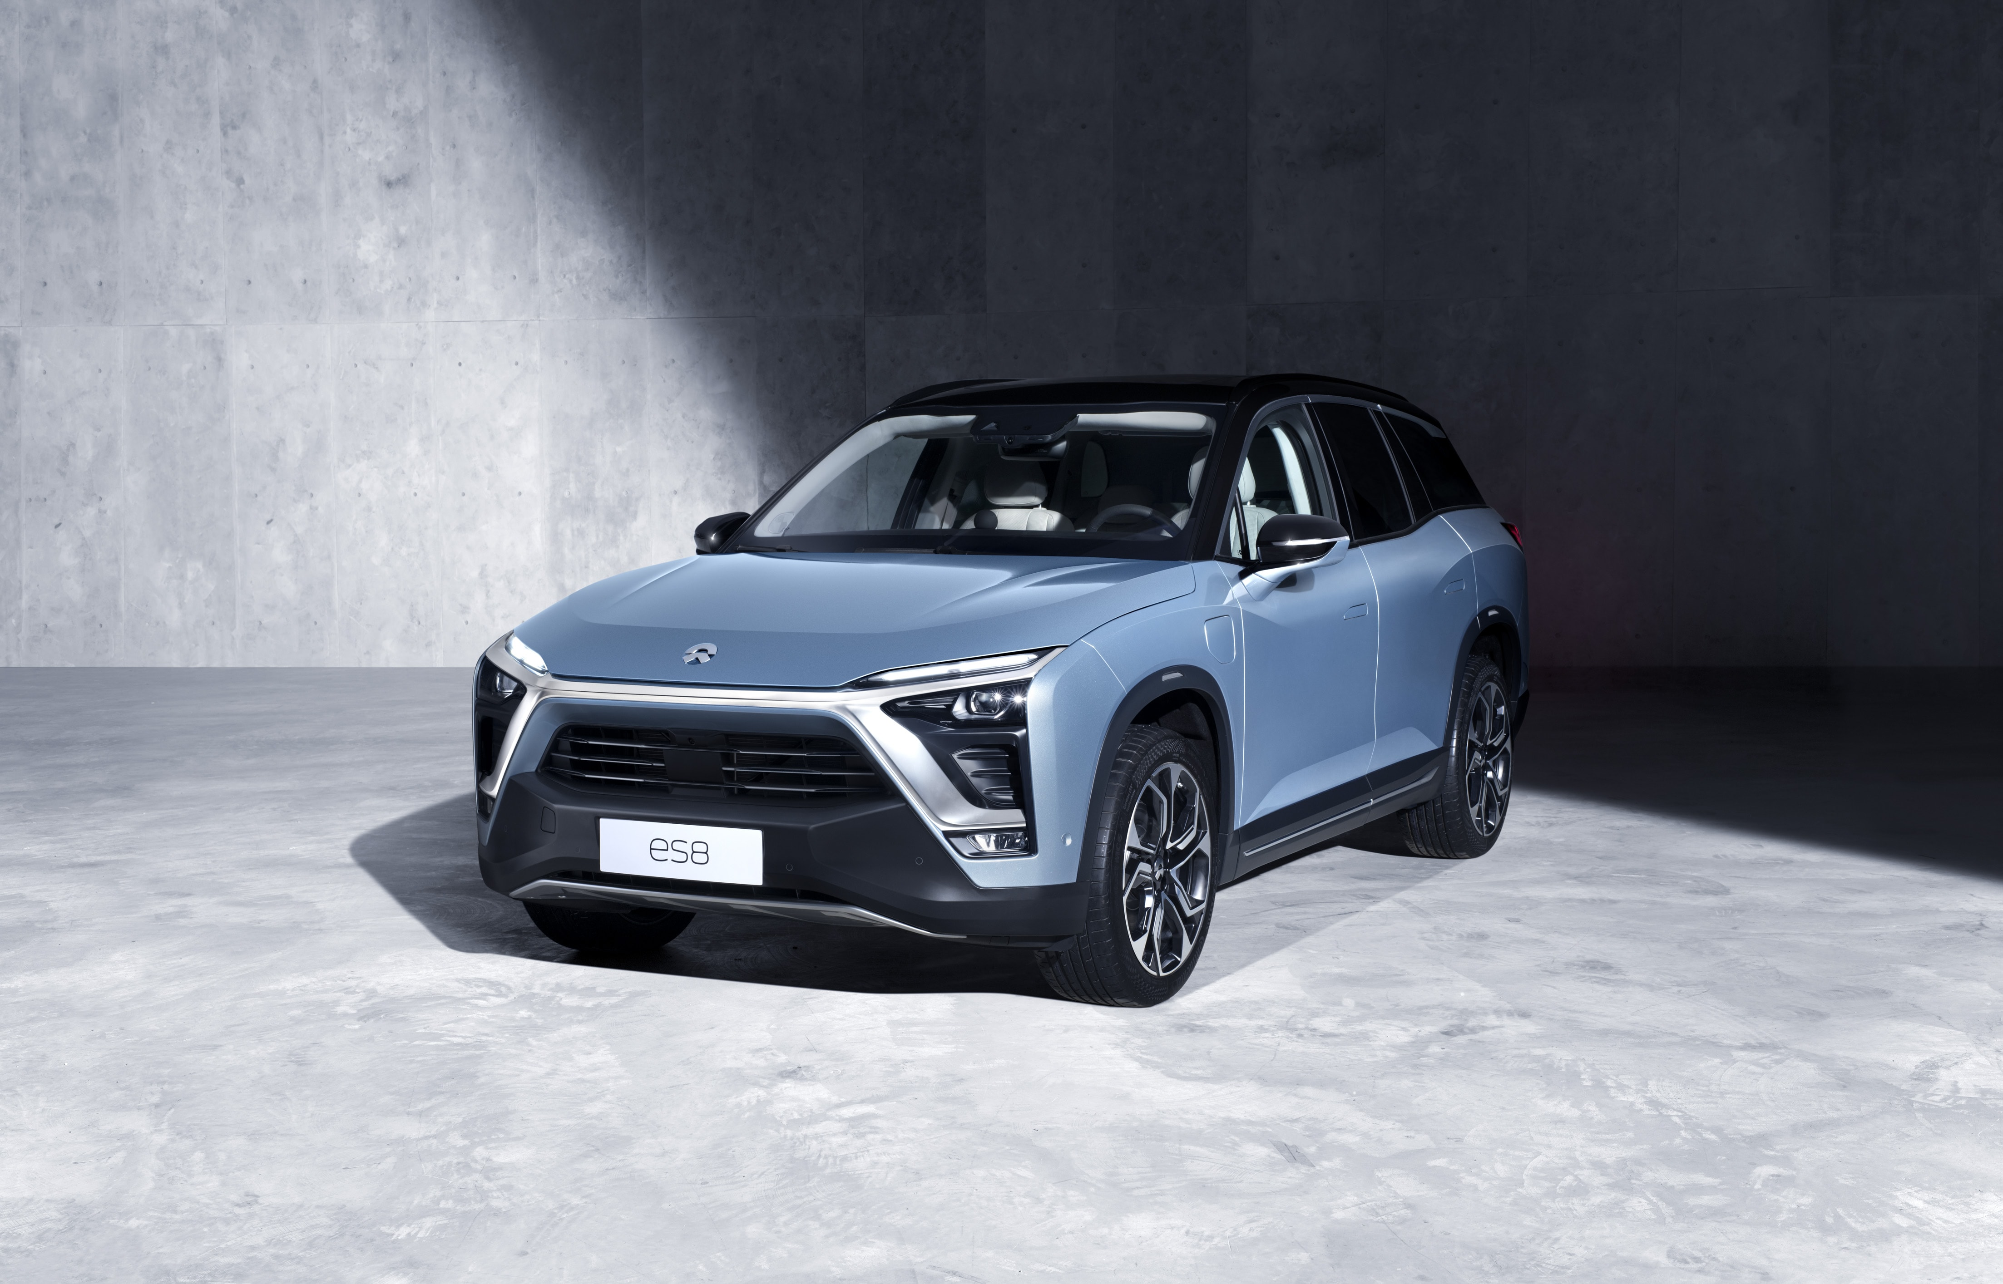

02
About NIO
NIO is a Chinese automobile manufacturer headquartered in Hefei, specializing in designing and developing electric autonomous vehicles. The company is also involved in the FIA Formula E Championship, the first single-seater, all-electric racing series.
NIO was founded in November 2014 by William Li, the Chairman of Bitauto and NextEV. After launch, several companies invested in NIO, including Tencent, Temasek, Baidu, Sequoia, Lenovo and TPG.¹
NIO ES8
NIO ES6
1 https://en.wikipedia.org/wiki/NIO_(car_company)

Slide 10
02
Key Events
NIO’s Chinese name, Weilai, which means Blue Sky Coming, reflects their vision and commitment to a more environmentally friendly future.¹
The first model – the EP9 supercar was introduced in 2016. Combined with an attractive design and strong driving performance, the EP9 delivers extraordinary acceleration and best-in-class electric powertrain technology.
In October 2016, NIO announced that it had been given an "Autonomous Vehicle Testing Permit" by the California DMV and it would begin testing on public roads under the "Autonomous Vehicle Tester Program" guidelines as part of its autonomous vehicle program. According to the company, it planned to launch vehicles with level-three and level-four autonomy.
NIO launched its first mass-manufactured electric vehicle, the ES8, to the public on December 16, 2017 and began making deliveries from June 28, 2018. The ES8 is a 7-seater premium electric SUV that offers exceptional performance, functionality and mobility lifestyle.
NIO officially launched the ES6, a 5-seater high-performance premium electric SUV, in December 2018 and began the first deliveries of the ES6 in June 2019.
NIO filed for a US$ 1.8 billion IPO on the New York Stock Exchange in September 2018.
In late April 2020, NIO announced ~$1B in new funding from a group of Chinese investors.²
1 https://ir.nio.com/governance/company-profile
2 https://en.wikipedia.org/wiki/NIO_(car_company)

Slide 11
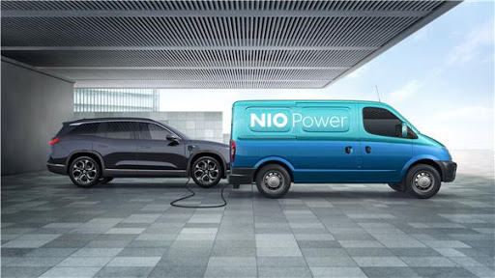

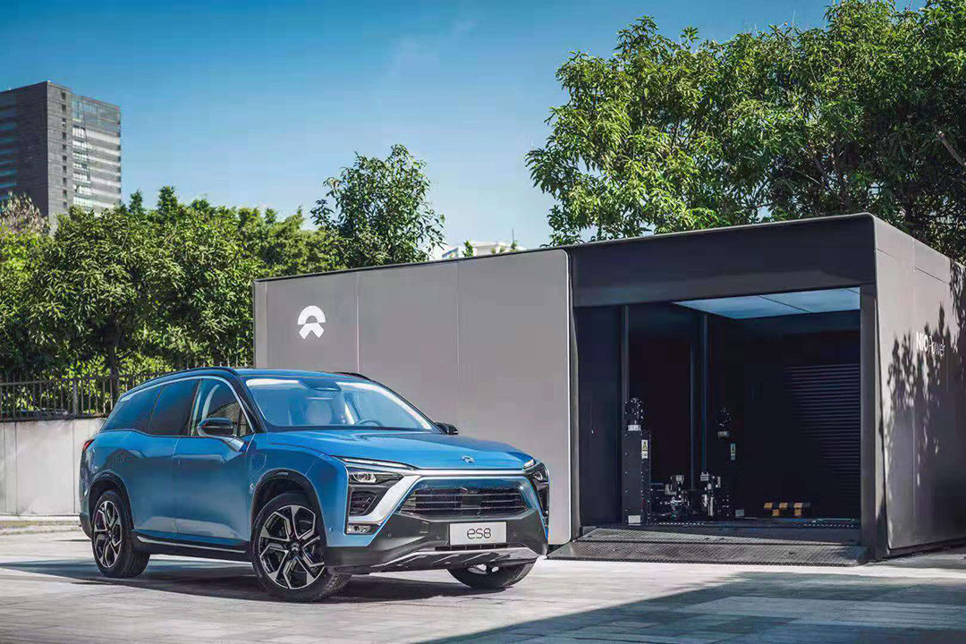
02
Key Services
NIO focuses on comprehensive value-added services and solutions, including
Power Home – home charging solution
Power Swap – battery swapping service
Power Mobile – mobile charging service through charging trucks
Power Express – 24-hour on-demand pick-up and drop-off charging service.
NIO opened its first battery swap station in Shenzhen, Guangdong, China in May 2018. As of May 2020, NIO has opened 131 power swap stations in 58 cities across China.
NIO Pilot – NIO’s autopilot system now offers Level 2 Autonomy for all of its car models.
NIO is extending its fashion line and collaborating with first-class designers under the company’s clothing collection NIO Life.¹
1 https://en.wikipedia.org/wiki/NIO_(car_company)

Slide 12
PART THREE
Valuation & Analysis
03
Advantage, Risk, Ratios, Stock, Forecast

Slide 13
03
Advantage
NIO focuses on personalized ownership experience and devotes to build a whole community around each NIO product. NIO offers specialized services, such as mobile power supply via charging trucks, that take years and loads of capital to deploy, an advantage that other companies cannot overtake in the short run.
Starting from May 2020, authorities in China published a restriction on EVs that are eligible for national and local subsidies, but battery-swappable vehicles were exempted from the restriction. Up until August 2020, NIO is the only EV brand China that offers battery-swappable vehicle models in Chinese market.¹
As of May 2020, NIO had completed over 500,000 battery swaps on its vehicles and established itself as the first EV company to bring battery-swapping into practice, an achievement that none of its competitors, including industry leader Tesla, was able to make.
In April 2020, NIO reached an agreement with a group of investors led by the state-owned Hefei City Construction and Investment Holding (Group) Co., Ltd. The strategic alliance with state enterprises helped NIO move its new headquarter to Hefei and secure cash flow for its short-term operation.²
1 https://www.sohu.com/a/396710792_354973
2 https://www.nio.com/news/nio-enters-definitive-agreements-establishing-nio-chinas-headquarters-hefei

Slide 14
03
Risk
With Tesla’s entry into China and its production plan in Shanghai, NIO now faces pressure from not only local rivals but also the oversea industry giant. Tesla has a much larger manufacture scale (annual production of 150,000 units vs. NIO’s monthly production capacity of around 5,000).
As a common pattern in the industry, NIO has been burning cash (between $300 million and $400 million per quarter) at the current state of business and has not seen a stable profit yet. The existing bonds that mature at the end of 2020 also suggest the financial distress that NIO is about to face in the near future.¹
The outbreak of COVID-19 interrupted the uptrend sale pattern that NIO was achieving. The recovery of the market requires NIO to come up with response measures and adjust its strategy.
The worsening relationship between the U.S. and China poses potential obstacles for NIO’s current developing plans in California. Risks on a macro level also exist for NIO’s stock as it is listed on the U.S. market and a trade friction between the two countries would potentially harm its stock price.
1 https://investorplace.com/2020/03/significant-risk-remains-nio-stock/

Slide 15
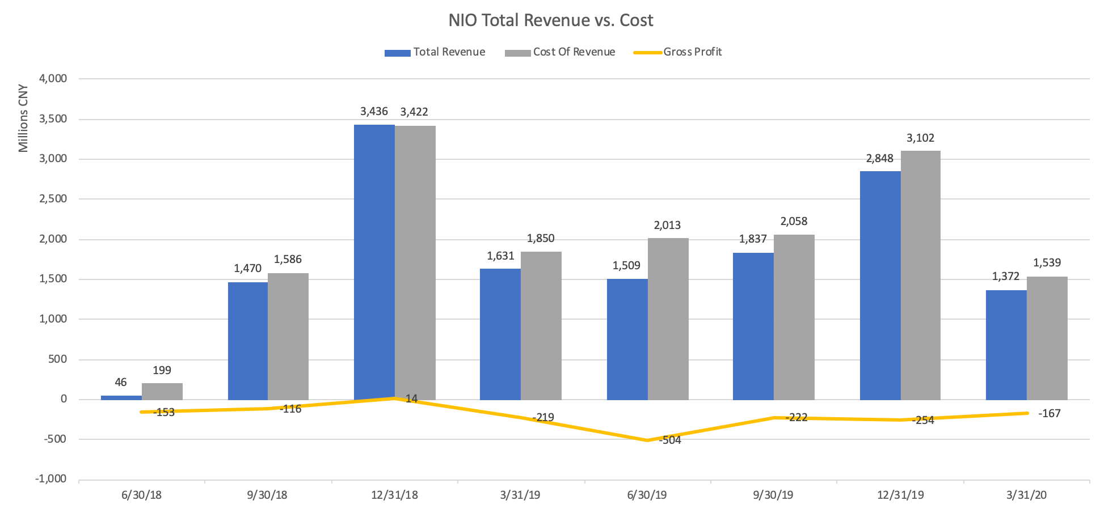
03
NIO Revenue & Cost
Even though NIO has not been able to earn a constant profit in recent years, it is showing the sign of a turnaround in profitability. Since 2019, NIO has been able to steadily grow its revenue while spending capitals on infrastructures of its power network and other services. The strong month-over-month growth of deliveries in Q2 and July 2020 forebodes a better financial performance in Q2 and Q3 2020.

Slide 16
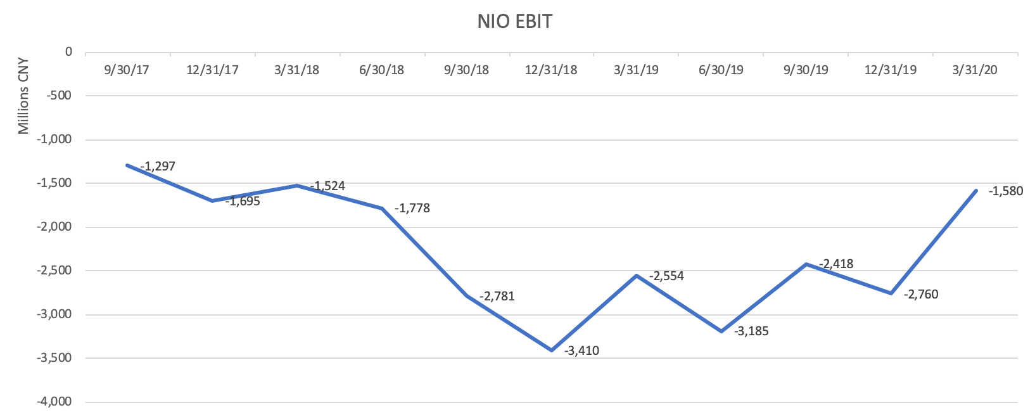
03
NIO EBIT
The quarterly EBIT of NIO has shown a fluctuated but uptrend pattern since 2019. Even under the influence of COVID-19 NIO posted an improvement in EBIT in the first quarter of 2020.

Slide 17
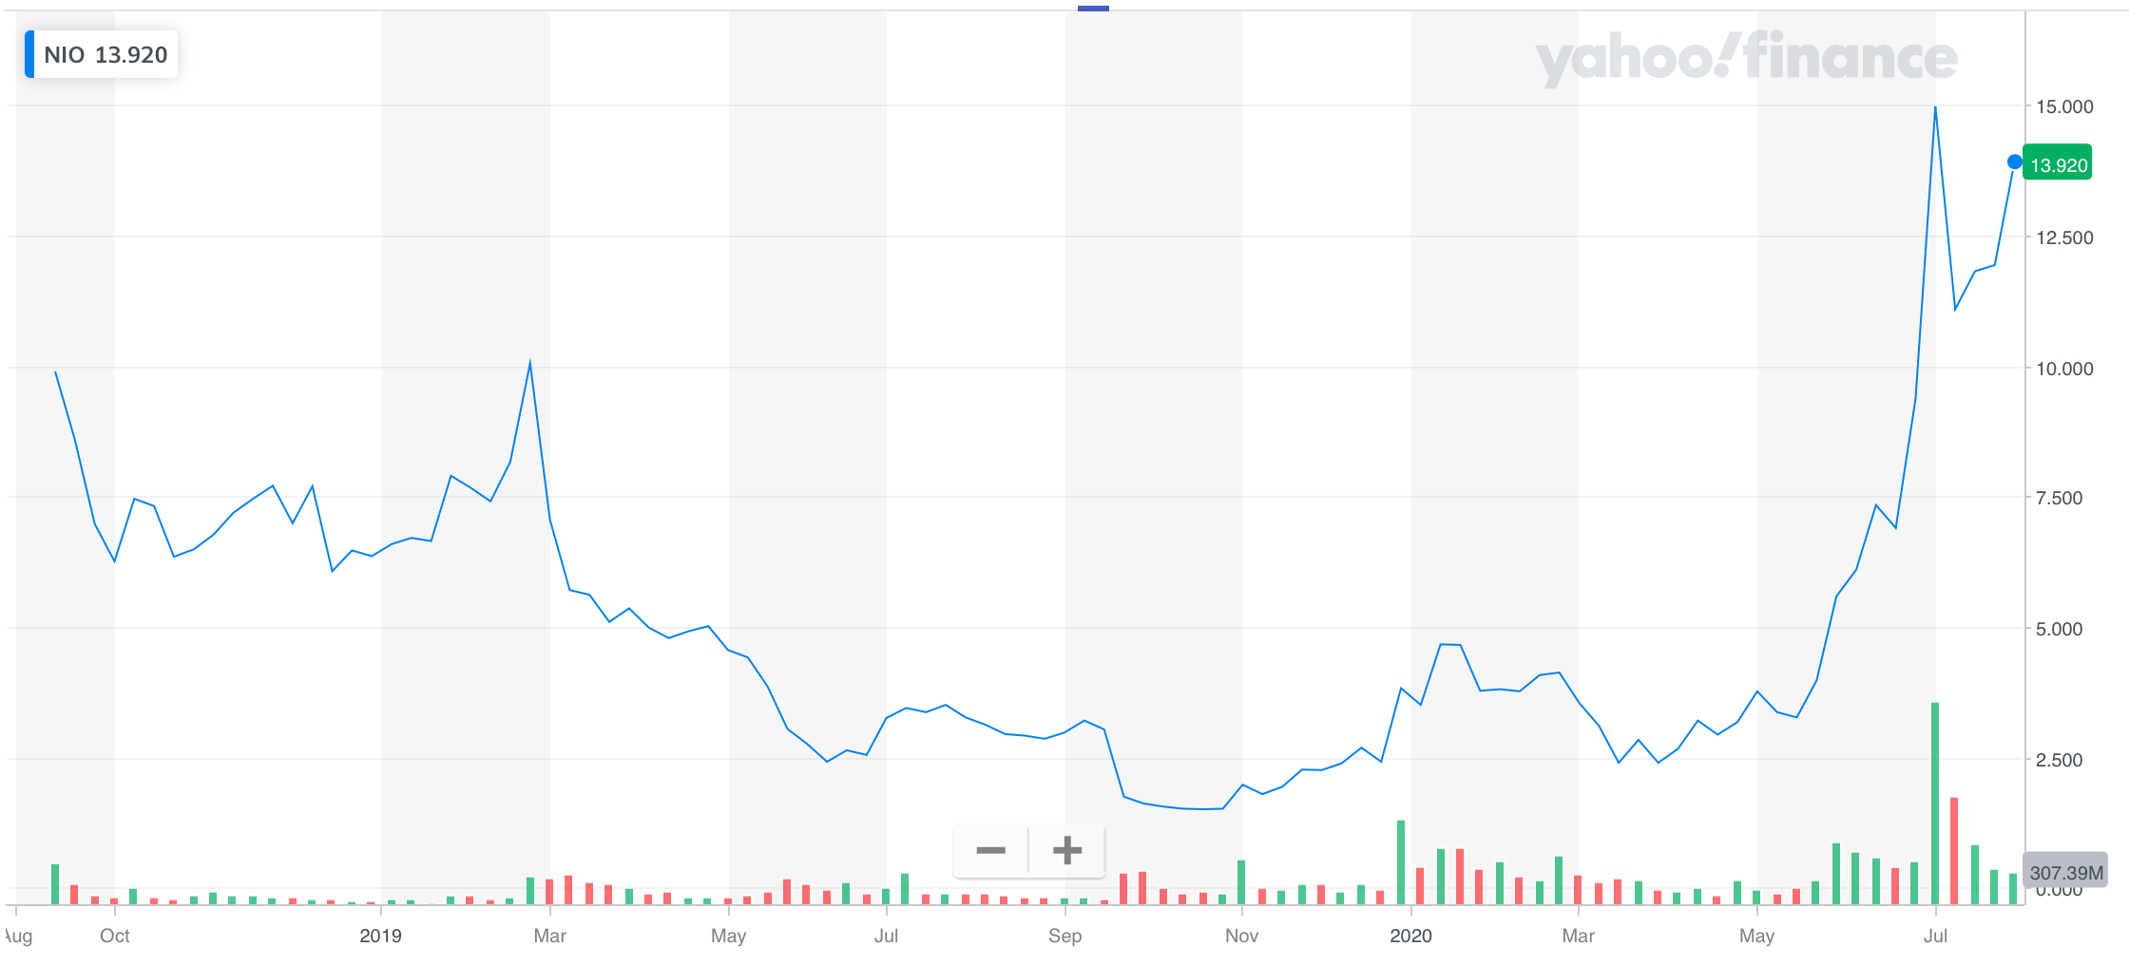
03
NIO Stock & Moving Average
Due to the unexpected operating loss and short of cash during 2019, NIO’s stock price experienced a dip to near $1.5 around November 2019. However, the boom in deliveries in the last quarter helped pull the price back to near $5. Coming into 2020, NIO’s price dropped due to the global pandemic but since March the price surged all the way to a high of $15 due to growth in deliveries as well as agreement with Chinese state enterprises.

Slide 18
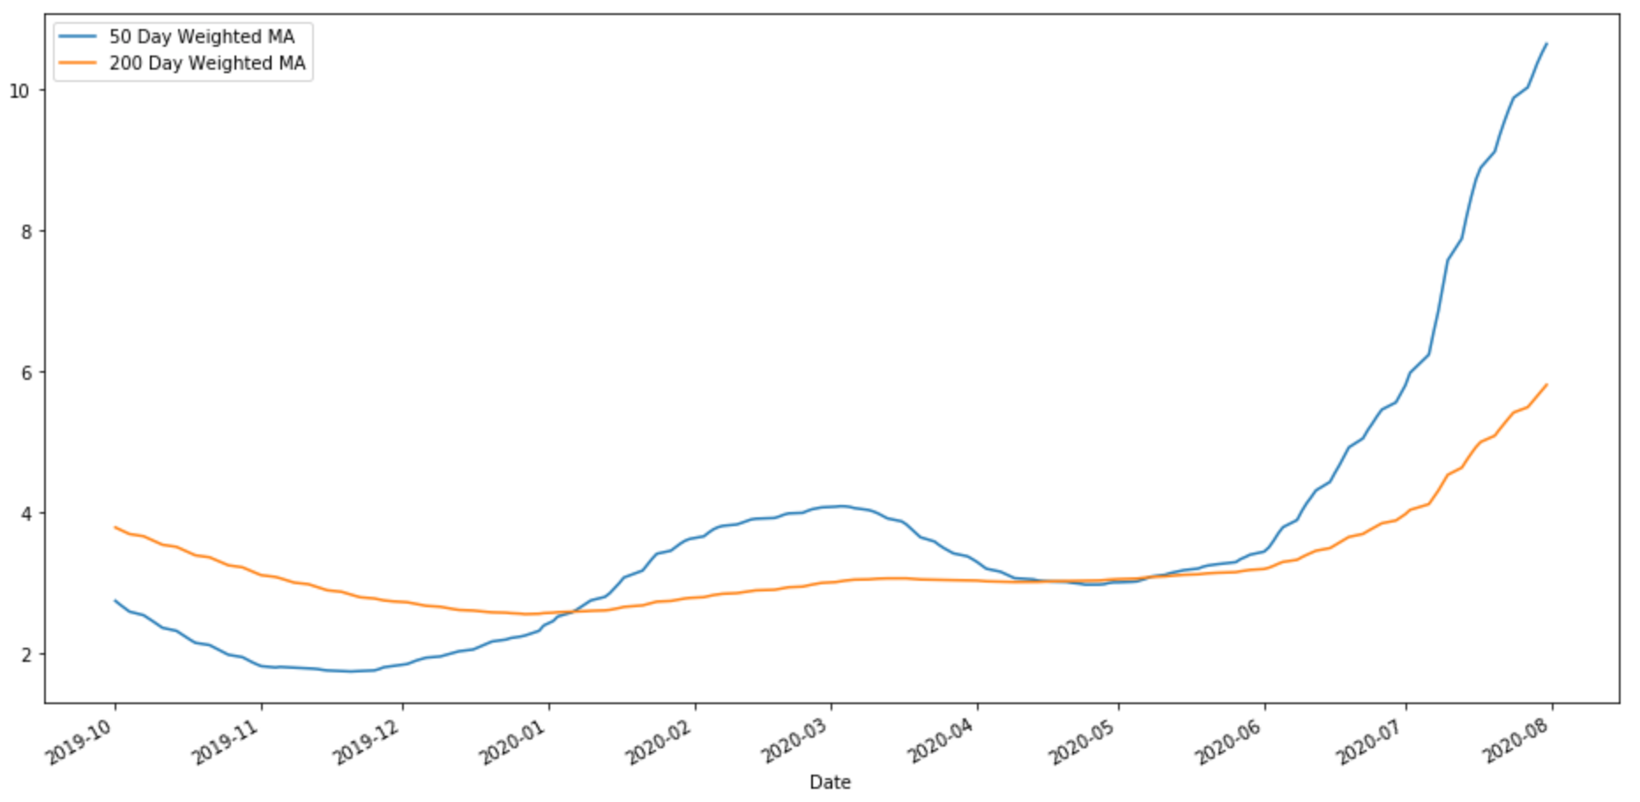
03
NIO Stock & Moving Average
NIO’s growth rate and its upward trend are reflected in the 50-day vs. 200-day Weighted Moving Average graph. The fact that currently the short-term average is above the long-term average verifies NIO’s recent enhancement in stock performance.

Slide 19
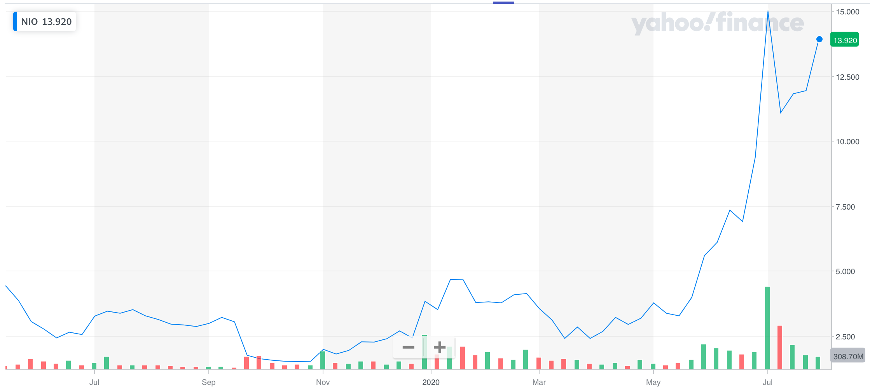
03
NIO Stock under COVID-19
Currently, the majority of NIO’s operation focuses itself on Chinese market which has been, earlier than most other economic entities, recovering from the impact of COVID-19 since March 2020.
Despite the drop in stock price due to the outbreak of COVID-19 in early 2020, NIO’s stock rallied by about 50% in early July 2020 given the strong Q2 delivery growth (169% sequentially). The mid-July debut of the sale plan of its third mass production vehicle as well as the 322% year over year delivery growth in July gave the stock another boost.
These are signs that NIO is returning to its normal state of production and sale.

Slide 20
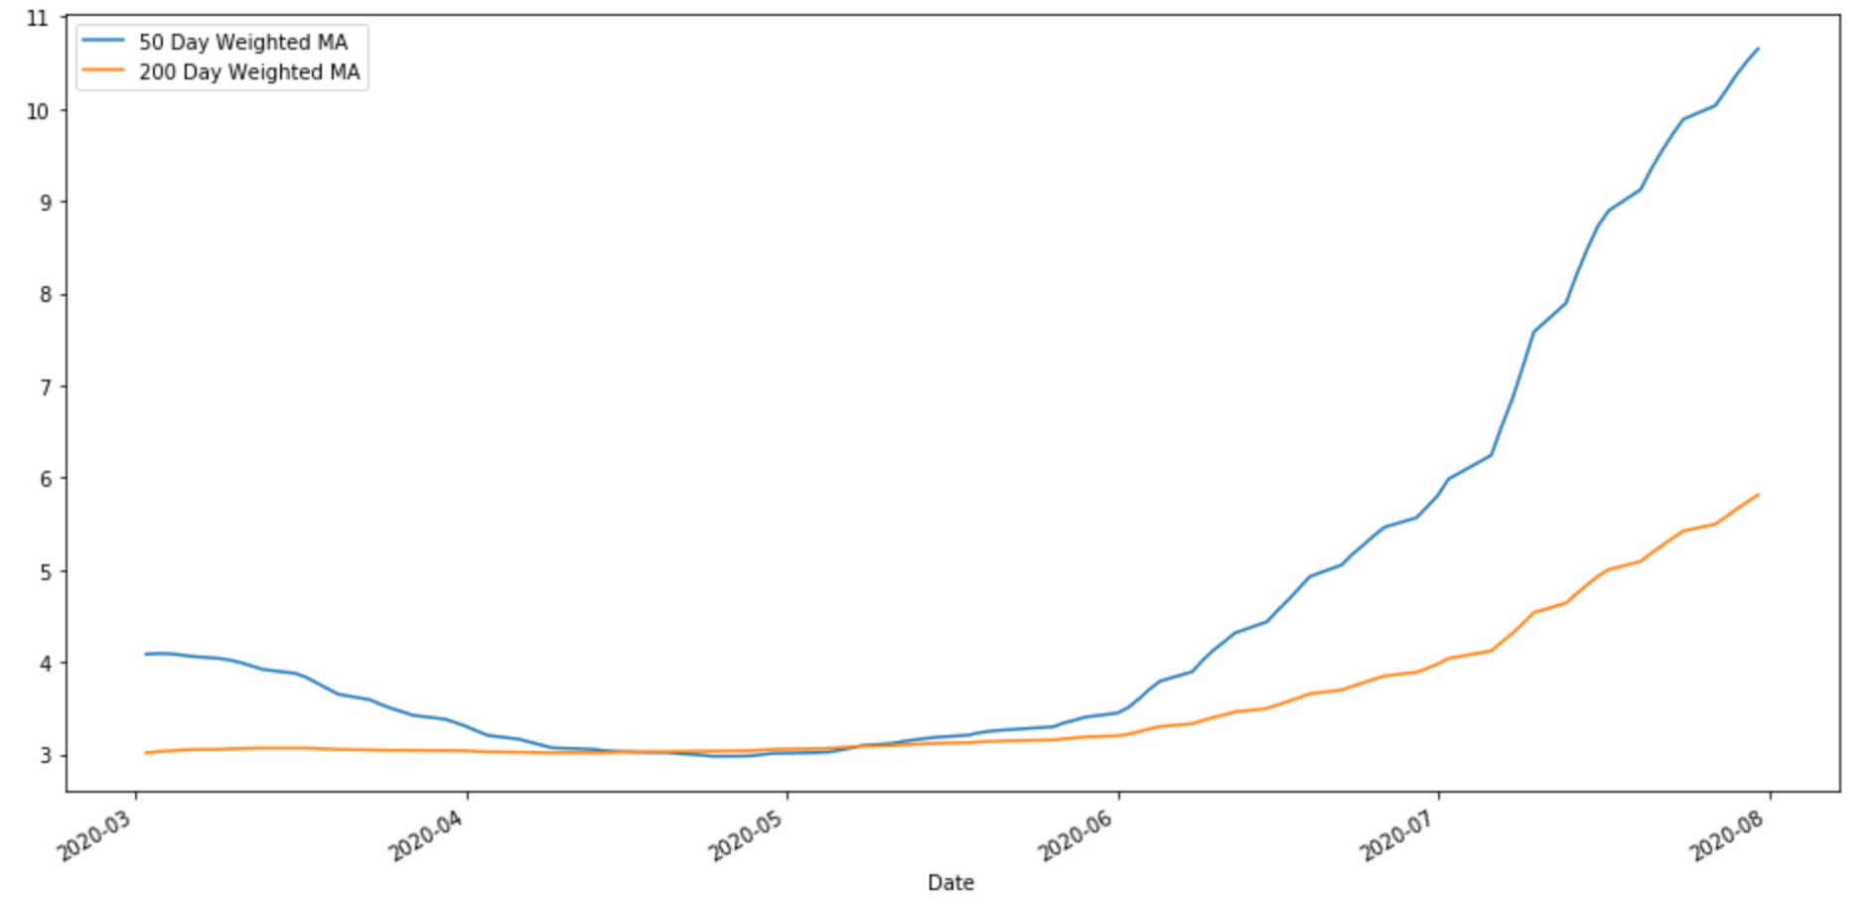
03
NIO Stock Moving Average under COVID-19
The short-term WMA went down when the financial panic struck the market beginning in March, and it momentarily crossed below the long-term WMA before pulling back around May. Since then the short-term line has been flying above the long-term line and has shown no sign of flattening, signaling the stock’s bouncing out of the impact caused by COVID-19.

Slide 21
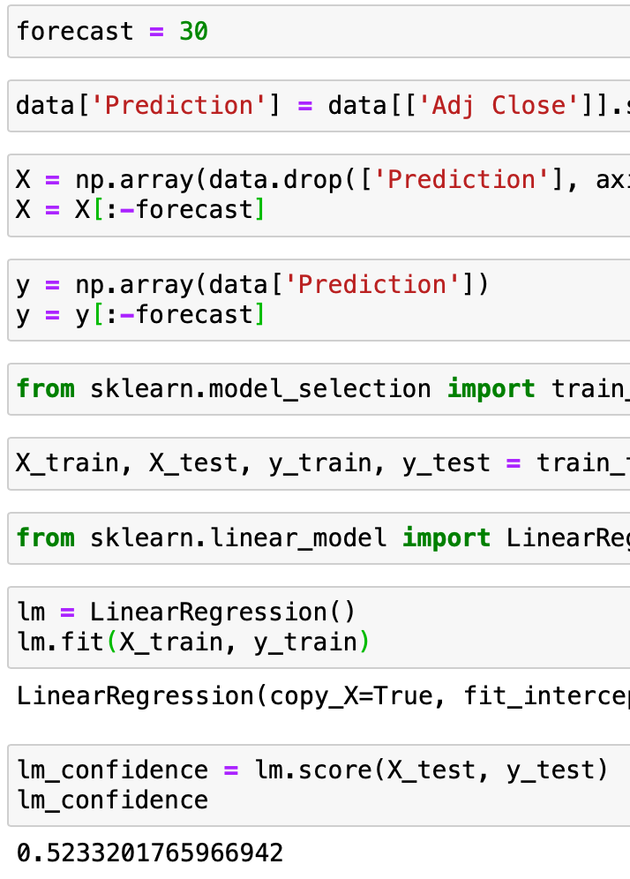
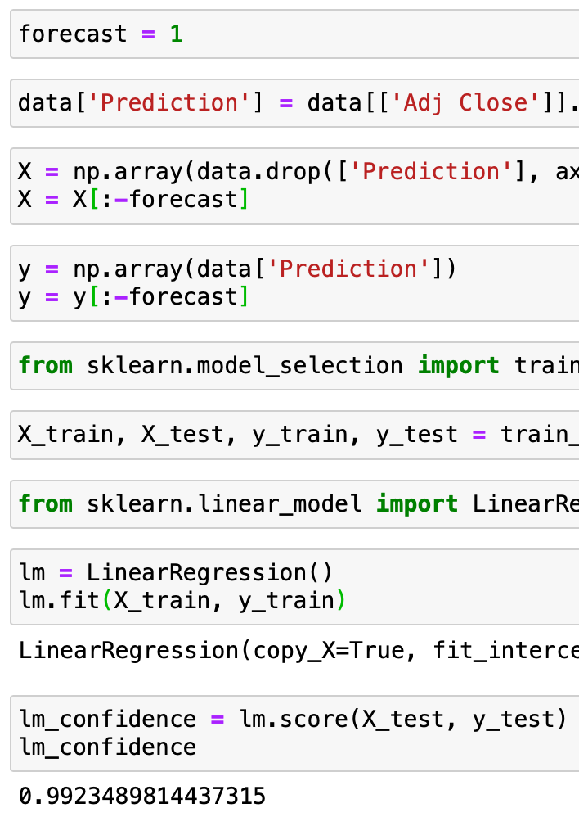
03
NIO Stock with Linear Regression
Using Linear Regression on NIO’s daily closing price as well as trading volume, we are able to get a model with a 0.538 R-squared value when applying a 30-day forecast window (lag). The R-squared value of the model decreases as the window decreases; when the window drops to 1 day the R-squared value becomes 0.992.
In order for us to look further into the future, a large forecast window is necessary, but the poor performance of the model (with a small R-squared value) means that the current model is not very reliable in predicting future stock price for NIO. Diminishing the forecast window to improve the model’s performance makes no sense as well since such a short-term forecast does not help much with the client’s investment decision-making.

Slide 22
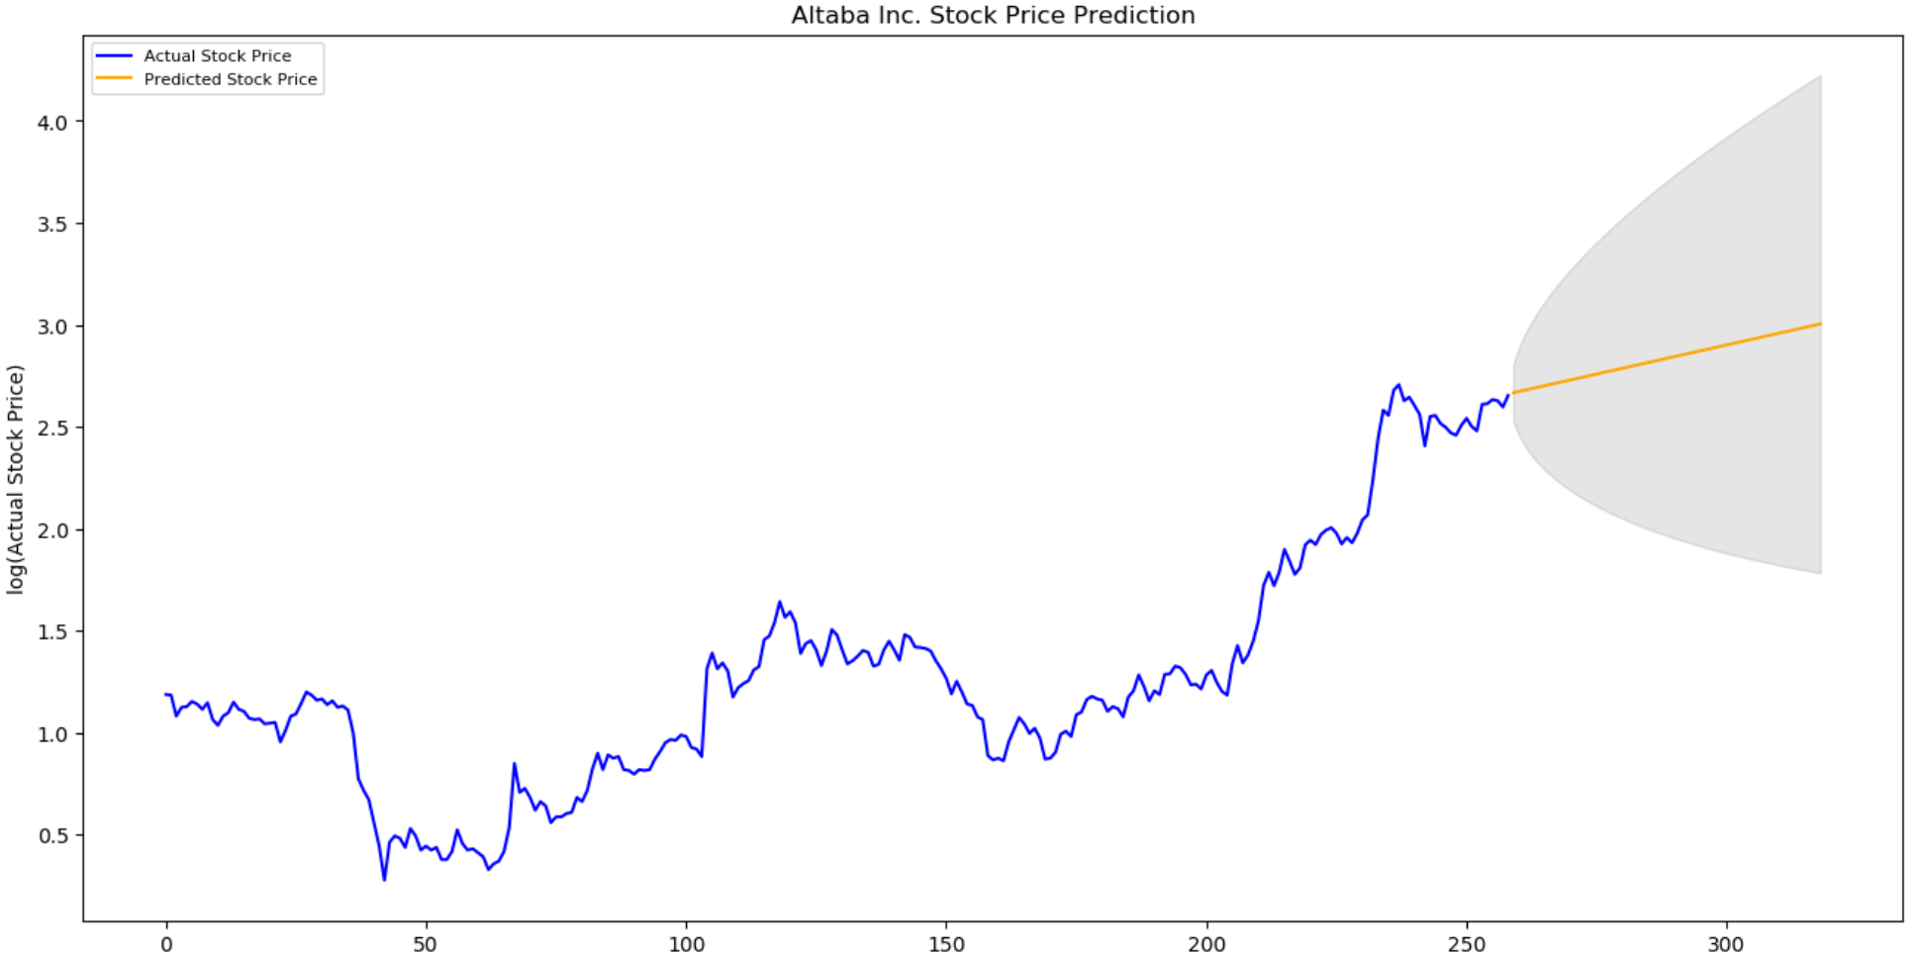
03
NIO Stock with ARIMA Model
The automated ARIMA model trained with NIO’s stock performance in the past year gives NIO an upward prediction.
One vulnerable aspect of the ARIMA model is that NIO’s stock performance has not been the most steady since its IPO as the company is still working on its cash flow and profit pattern and expanding or diminishing the training data span will lead to the upshift or downshift of the prediction line. The current model is trained with a one-year price span.

Slide 23
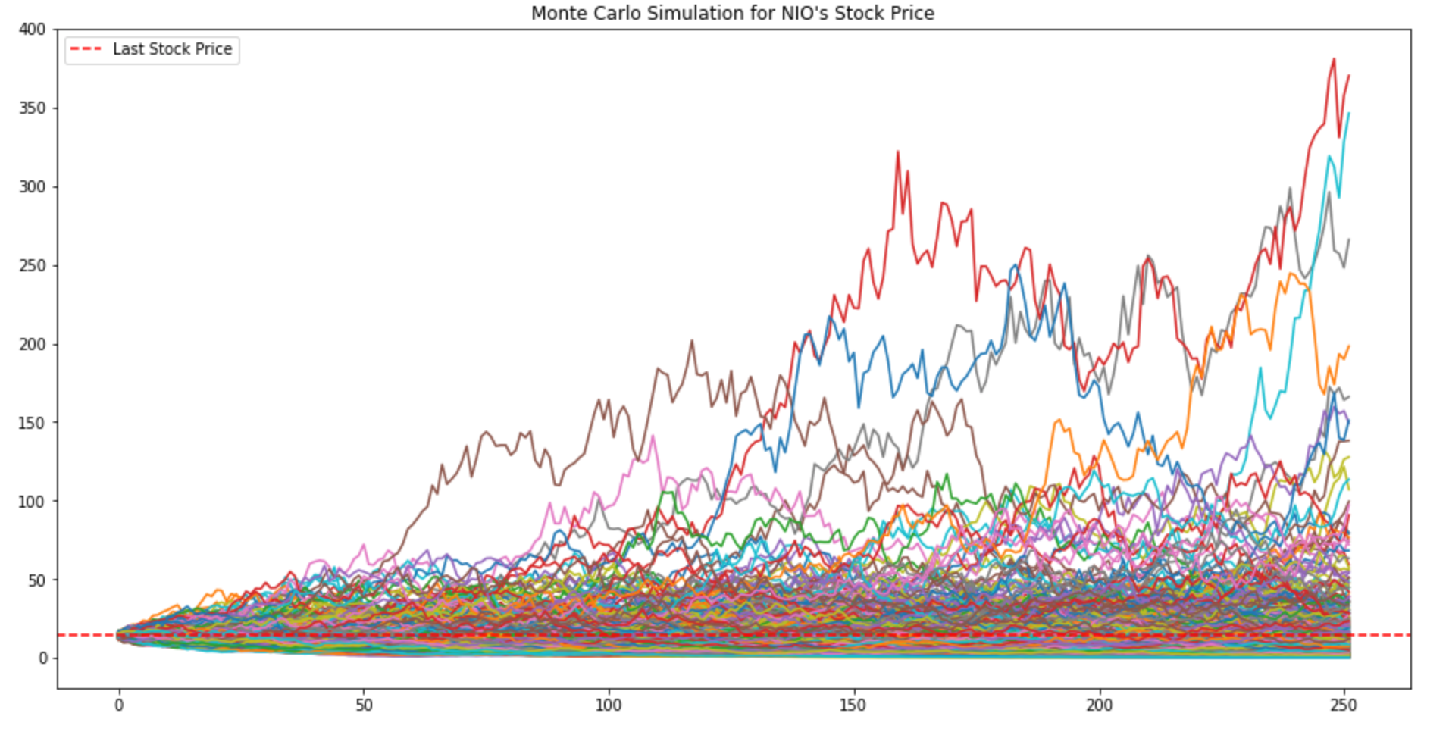
03
NIO Stock with Monte Carlo Simulation
A 500-iteration, 252-day Monte Carlo Simulation based on NIO’s performance in the past 12 months produces the above graph for its future price in one year. The minimum value achieved in one year from now is around $0.1 and the maximum is around $370.

Slide 24
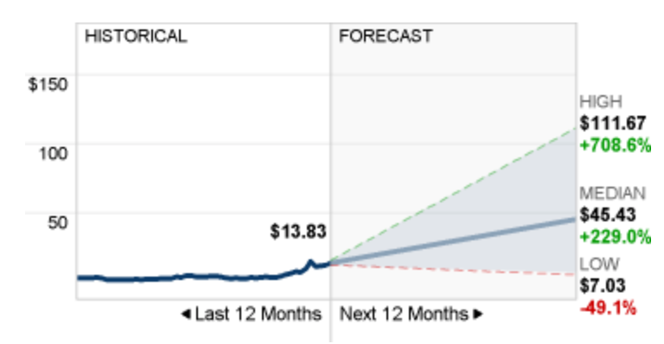
03
NIO Stock Forecast by Financial Analysts
According to CNN Money, as of August 6, 2020, the Next 12 Months prediction of NIO’s price has a median of $45.43 (+229.0%), with a high of $111.67 (+708.6%) and a low of $7.03 (-49.1%).¹
1 https://money.cnn.com/quote/forecast/forecast.html?symb=NIO

Slide 25
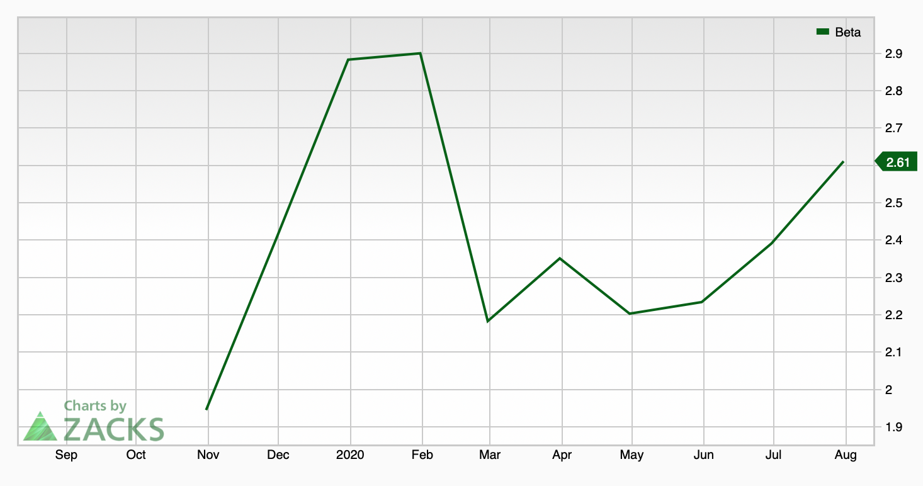
03
Beta for NIO
According to ZACKS, currently NIO has a beta of 2.61, which suggests that it is 2.61 times as volatile as the market.¹ Its beta rocketed to around 2.9 during the outbreak of the pandemic before plummeted in March 2020. NIO is a relatively volatile security and a riskier investment, but it bears considerable potential return that other less-volatile competitors do not have.
1 https://www.zacks.com/stock/chart/NIO/fundamental/beta

Slide 26
Appendix
Financial Statements
04
Income Statement, Balance Sheet, Cash Flow

Slide 27
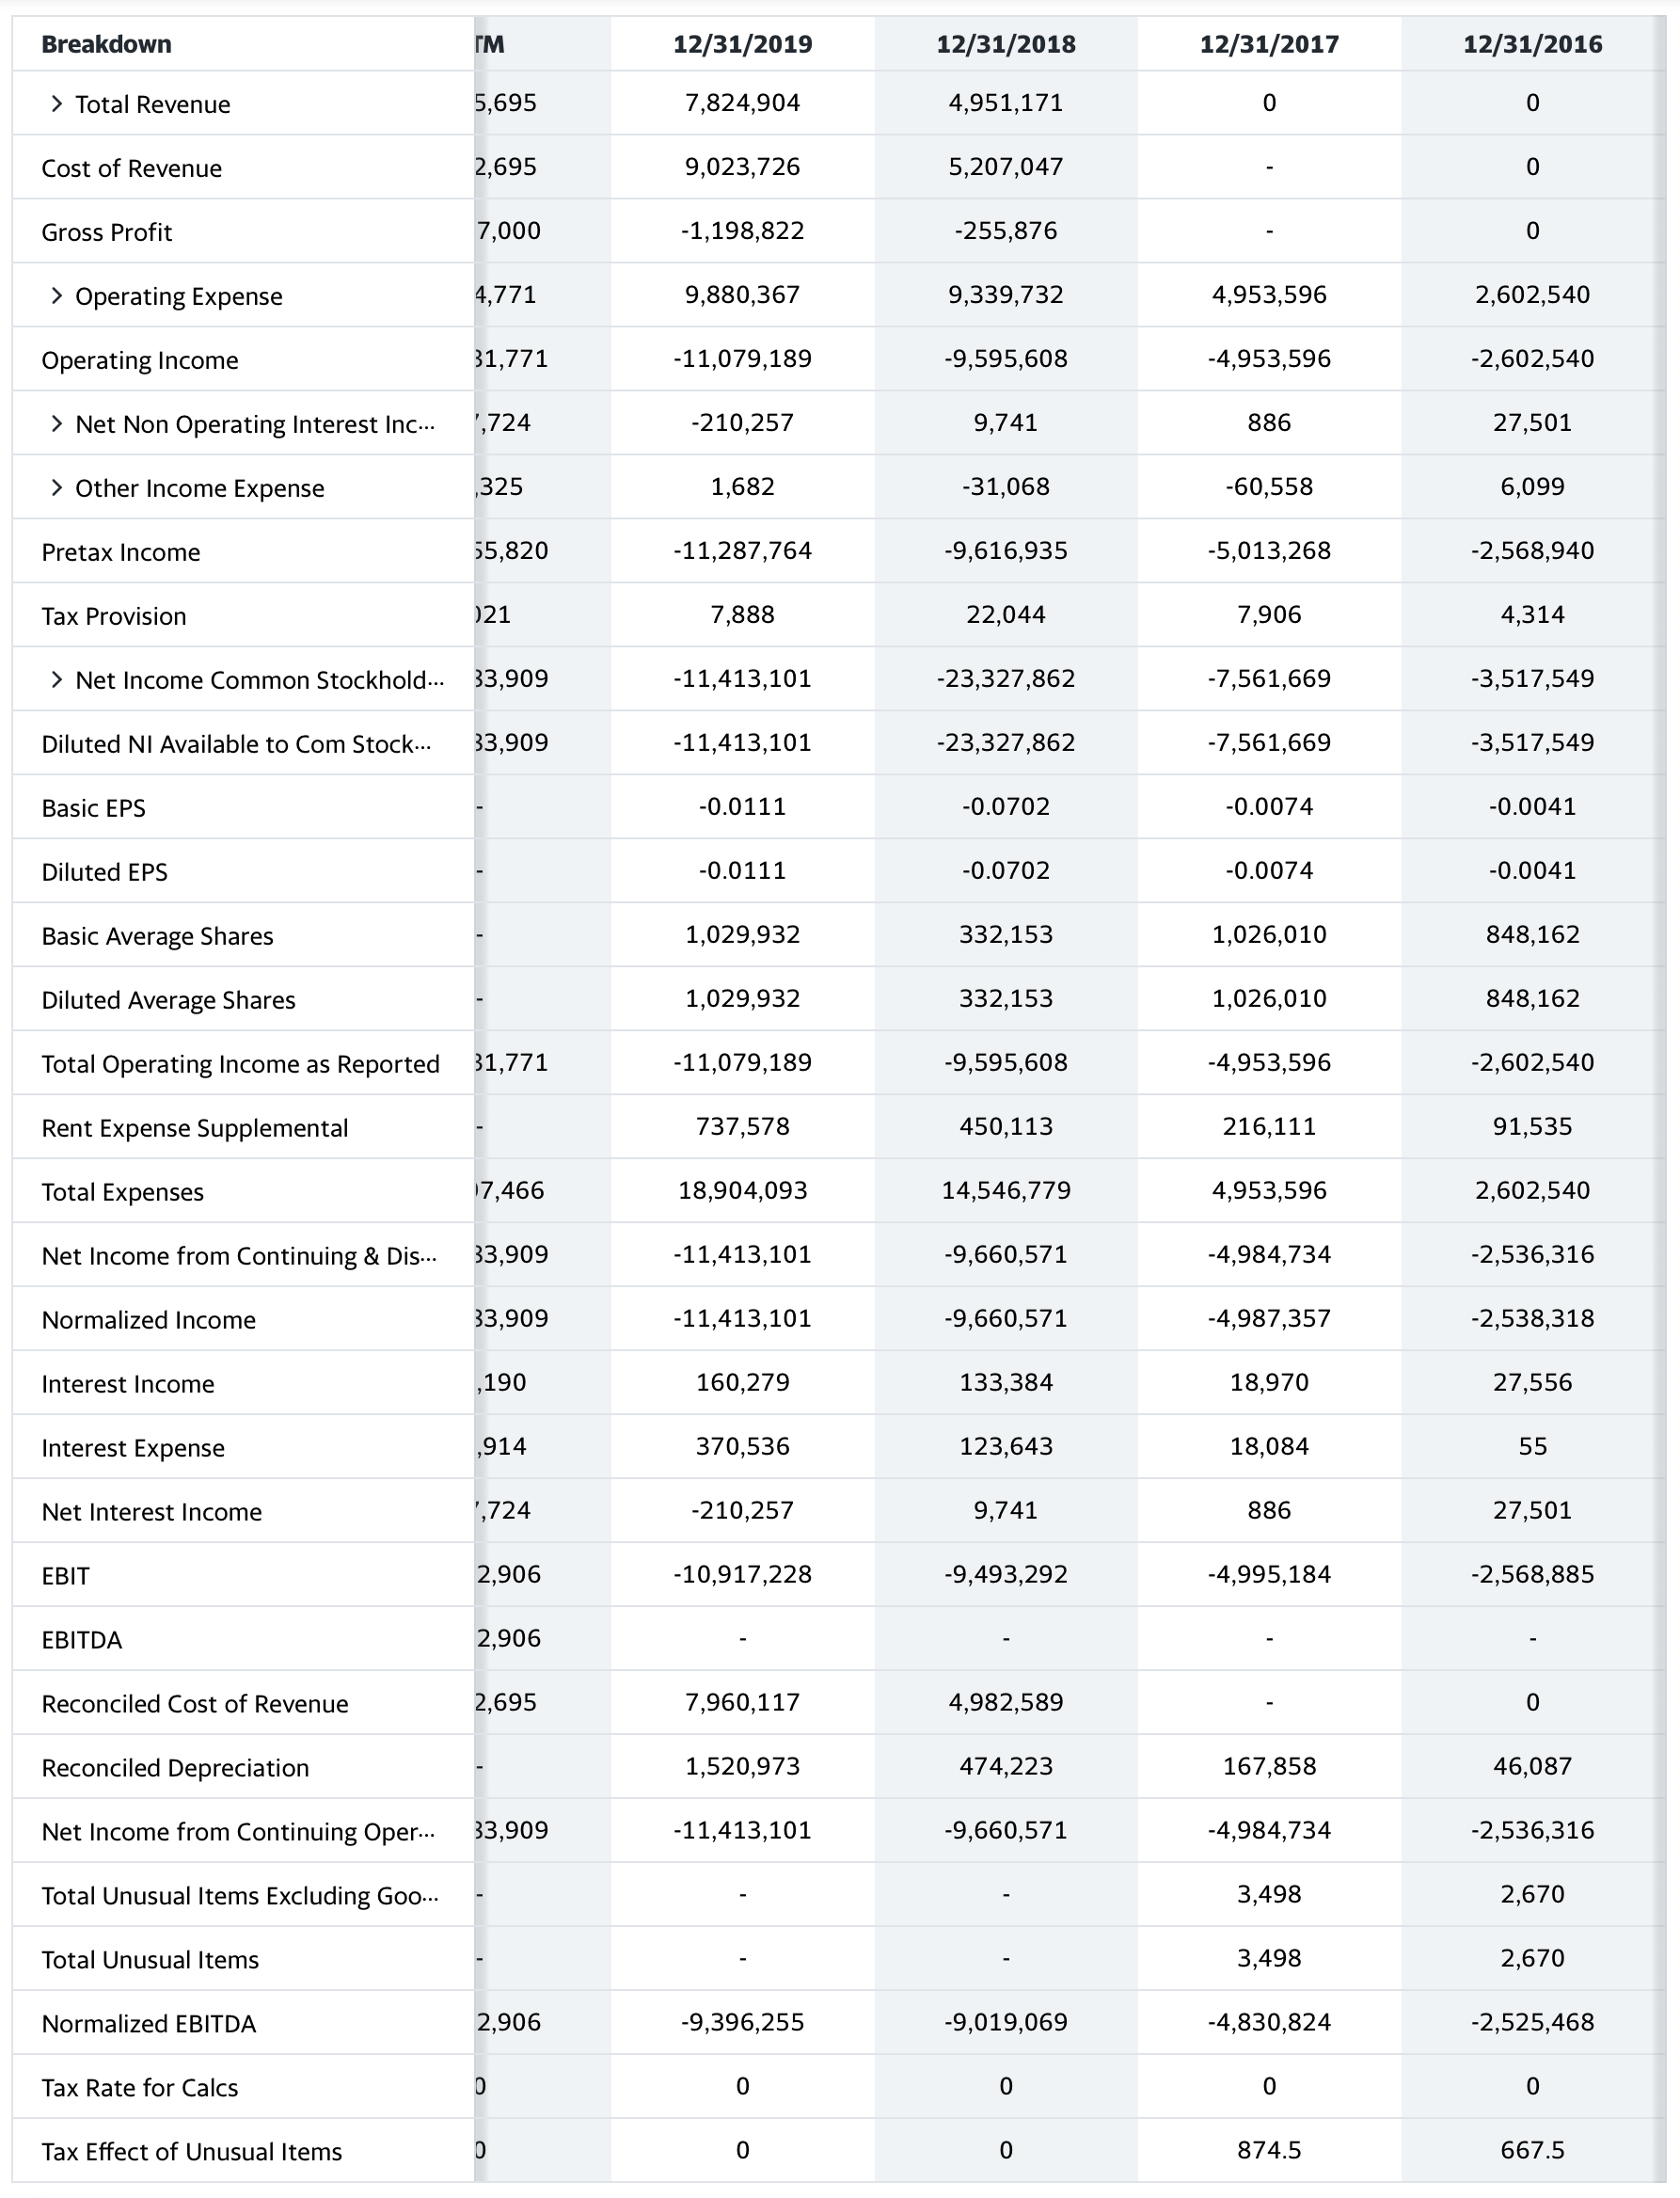
04
Income Statement
1 https://finance.yahoo.com/quote/NIO/cash-flow?p=NIO

Slide 28
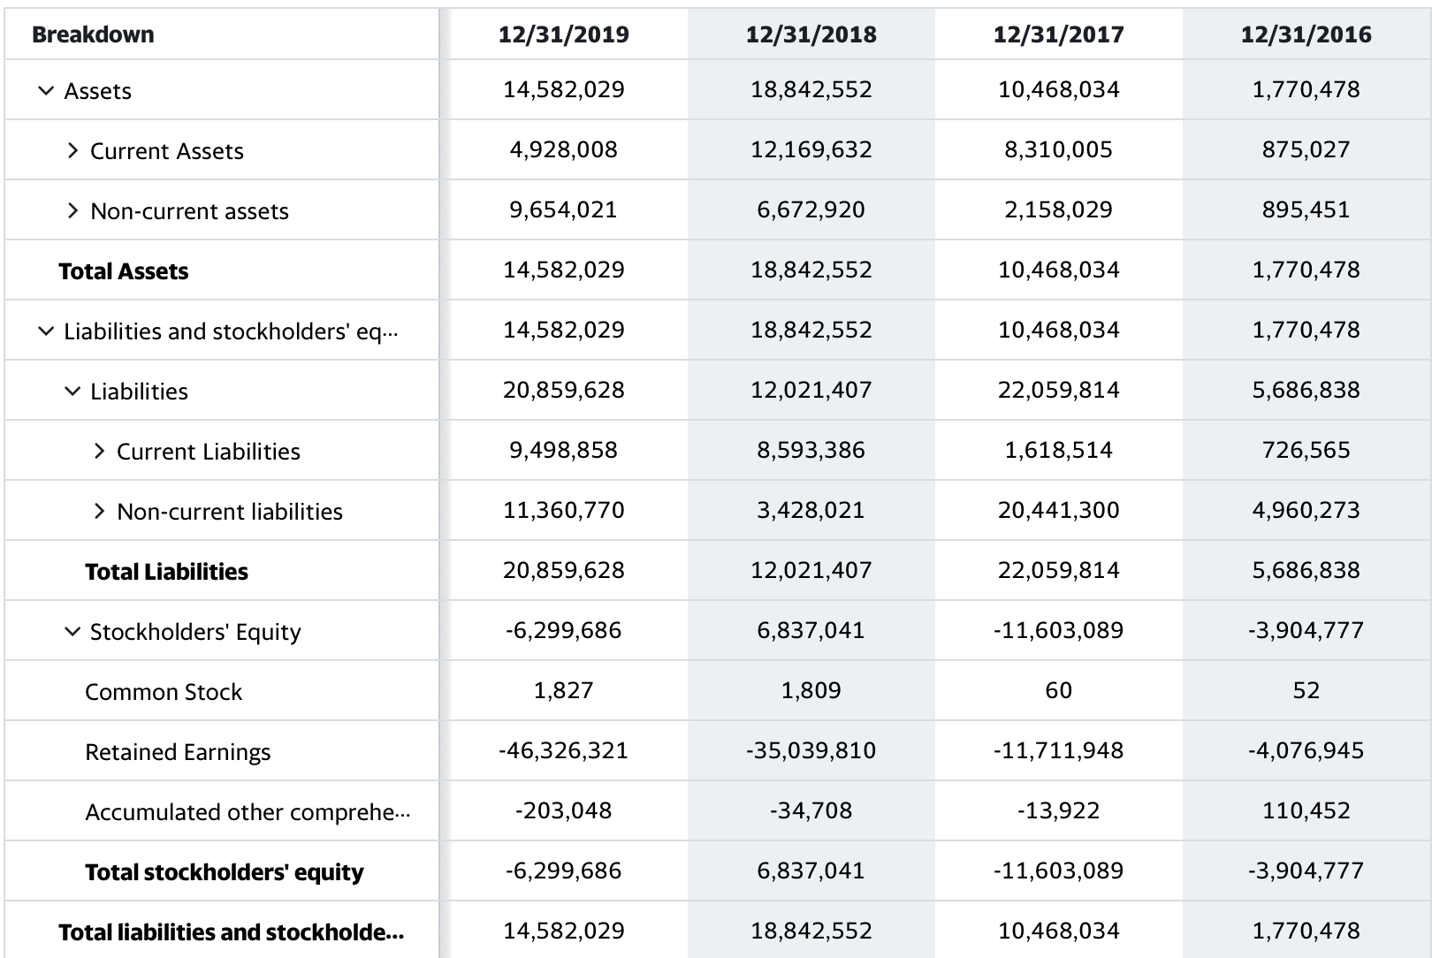
04
Balance Sheet
1 https://finance.yahoo.com/quote/NIO/cash-flow?p=NIO

Slide 29
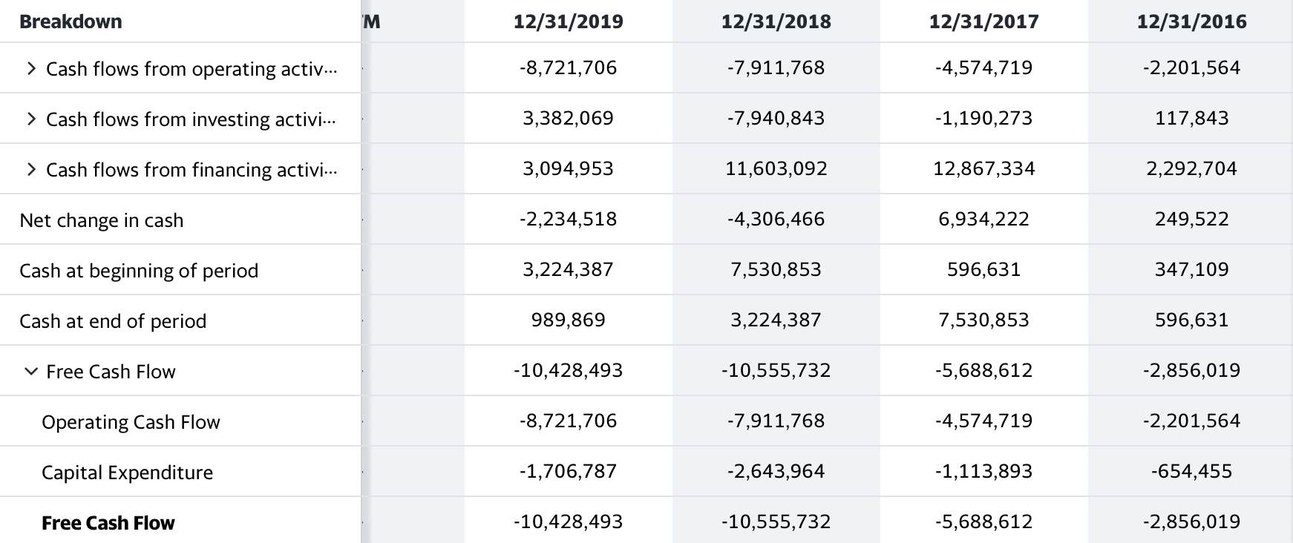
04
Cash Flow Statement
1 https://finance.yahoo.com/quote/NIO/cash-flow?p=NIO

Slide 30
Investment Recommendation
Recommendation
To sum up, NIO stock should be a buy not just for the short-run but for the long-run as well for the following reasons:
NIO’s core value, which is to build not just a vehicle but also a unique, life-long, all-dimensional and immersive after-sale relationship with its customers will help it to fetch a higher value in the market
NIO has allied with the Chinese government, which will help it secure certain level of cash flow; more preferential policies towards NIO are also highly possible to be in store
NIO’s innovative, nationwide power-swapping station network is about to go online, which will bring in a larger market share for NIO
NIO’s earnings, although currently negative, have shown a strong sign of becoming positive; vehicle delivery is growing at a constant rate; revenue and EPS are beating expectations even under the pandemic
NIO mainly serves the already-recovering Chinese EV market, and with its month-over-month growth in deliveries, bull news can be expected for Q2 an Q3 2020, which will push the price up
NIO’s stock has a huge upside potential given the various stock price forecasts

Slide 31
Thank you!

